Slide 1
Adult Census Income Binary Classification
Two – Class Support Vector Machine (SVM)

Slide 2
Learning Task
Classify people using demographics to predict whether a person earns over 50K a year.

Slide 3
Dataset
A subset of the 1994 Census database, using working adults over the age of 16 with an adjusted income index of > 100.
14 Features and 1 label column
Numerical features
Categorical features

Slide 4
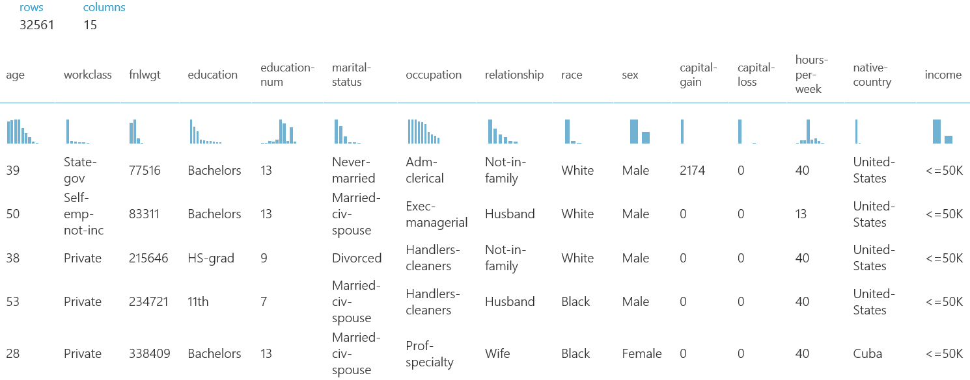
Features
https://docs.microsoft.com/en-us/azure/machine-learning/machine-learning-use-sample-datasets

Slide 5
Preprocessing
Strip

Slide 6
Post processing

Slide 7
Testing method

Slide 8
Performance metrics

